Slide 1
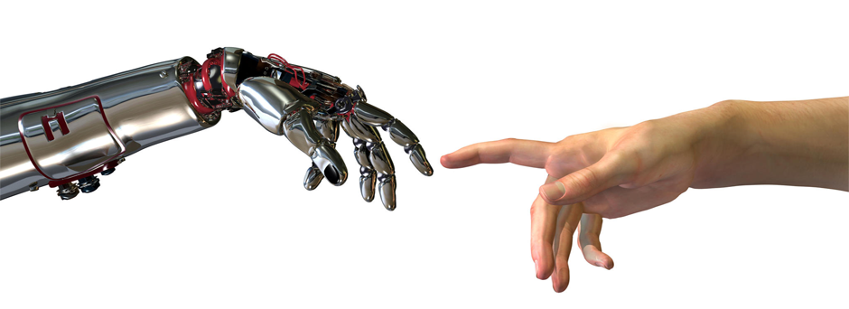
Optimizing HRI Interactions for NAO
Leonard Ramsey and Zoya Yeprem

Slide 2
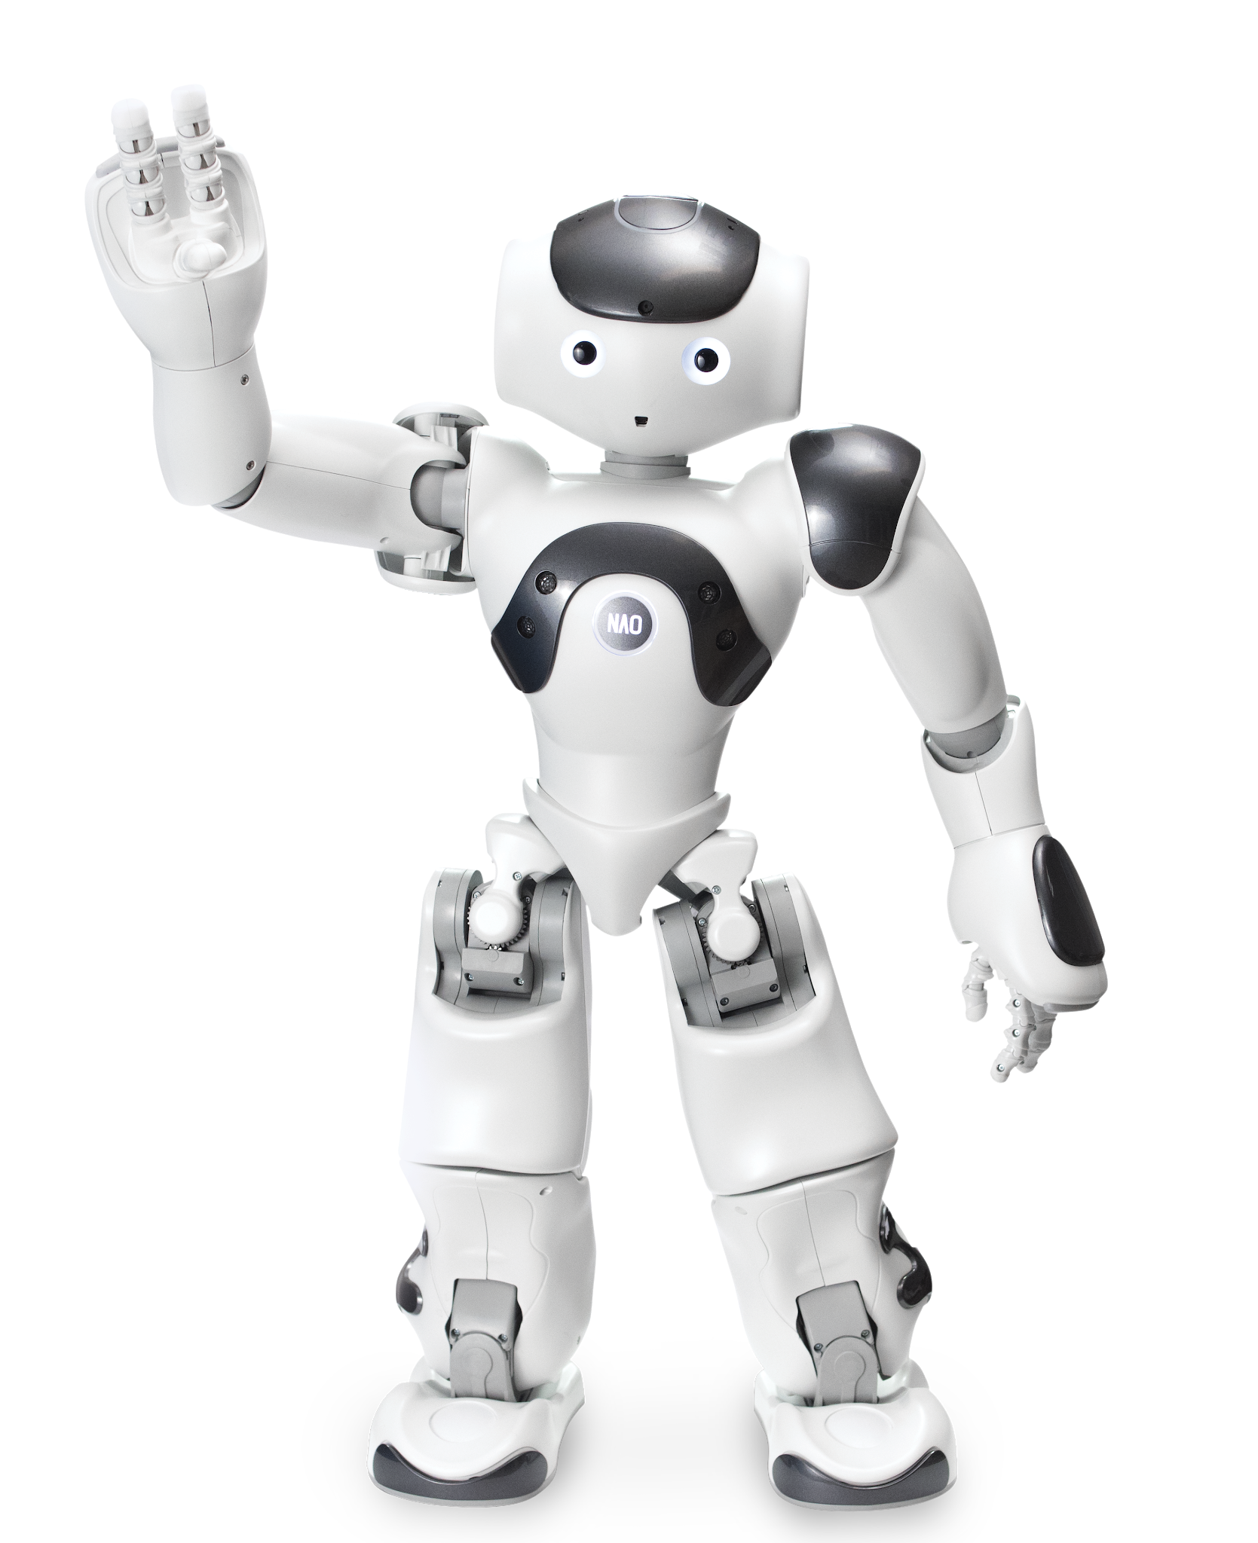
Introduction

Slide 3
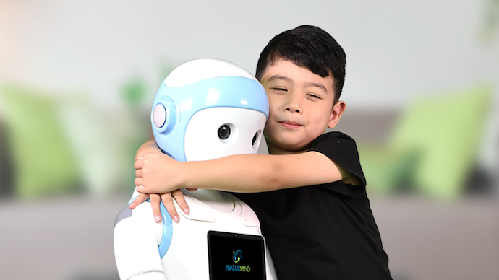
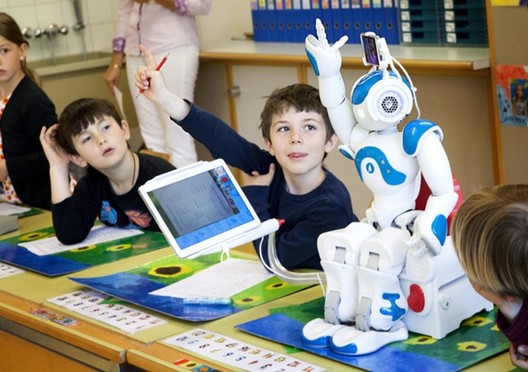
Motivation
Problem Statement
Robots and Humans
Robot companions are starting to be explored more
(e.g. Friends, Caretakers, Teachers)
Robots can consistently provide source of happiness and compassion that humans may not always be capable of
Not many applications of formal methods for robots operating in non-safety critical applications
iPal companion
Robots should be capable of optimally engaging with human users
NAO teacher

Slide 4
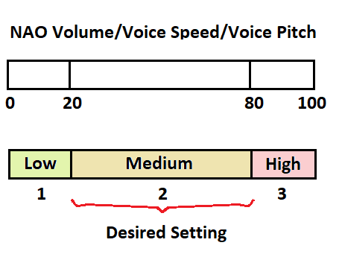
Assumptions
We will focus on optimal speech only and did not consider movement
Robot mood will correlate with human mood
There are three considered states volume, pitch, and speed (1/low, 2/medium, 3/high). We will consider “2” to be the ideal state.
We do not directly consider changes in the human mood in our model.

Slide 5
Approach

Slide 6
General Approach
Determine properties that should hold for system
Construct transition system that replicates possible interaction with human
Verify properties in transition system
Generate policy that follows properties
Implement on NAO

Slide 7
General Approach
Determine properties that should hold for system
Construct transition system that replicates possible interaction with human
Verify properties in transition system
Generate policy that follows properties
* Implement on NAO

Slide 8
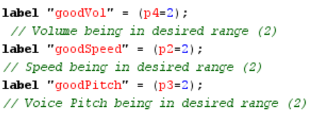
Properties
filter(avg, Pmax=? [F[1,212] "goodVol"])
filter(avg, Pmax=? [F[1,212] "goodSpeed"])
filter(avg, Pmax=? [F[1,212] "goodPitch"])

Slide 9
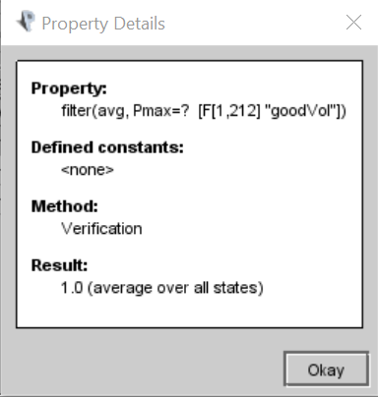
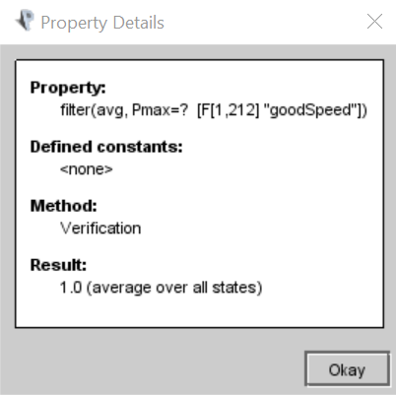
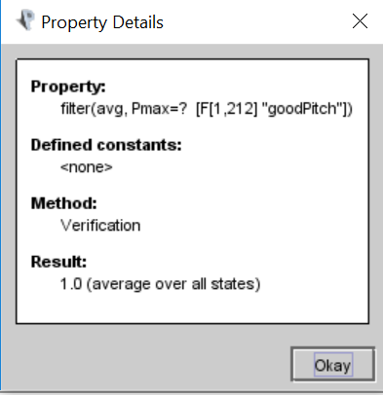
Results of Verification
* For our model we found that it takes at least 212 steps to guarantee with probability 1.0 that the model reaches these properties.

Slide 10
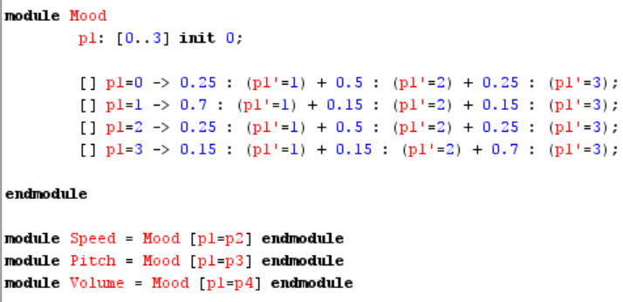
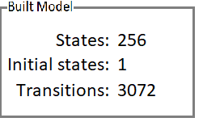
Model Overview
Notes:
<to verify system is feasible, we modelled transition system in PRISM>

Slide 11

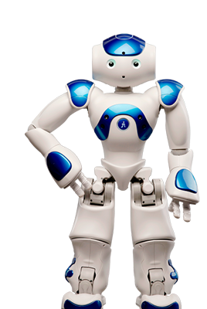

Implementation Overview
Specifications
Input
Algorithm
Output

Slide 12
Conclusion

Slide 13
Conclusion
There are not many applications for non-safety critical systems
So far, we have verified that our model satisfies properties relevant and important to this application
Next, we will look into using a solver to generate outputs for the NAO robot and complete an implementation

Slide 14
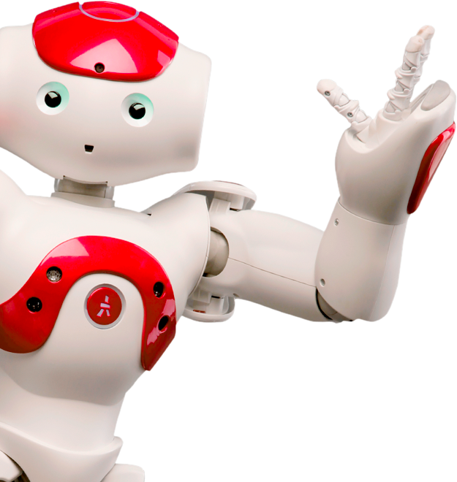
Questions?
?
?
?

